Slide 1

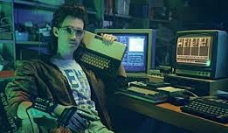

Do You Even Threat Intel Bro?
Raymond Confer

Slide 2
Who am I?
Cyber Threat Intel Lead at Trinet
Musician
Gamer
Vlogger
21 Infosec Certifications
Tech Boot Camp Instructor

Slide 3
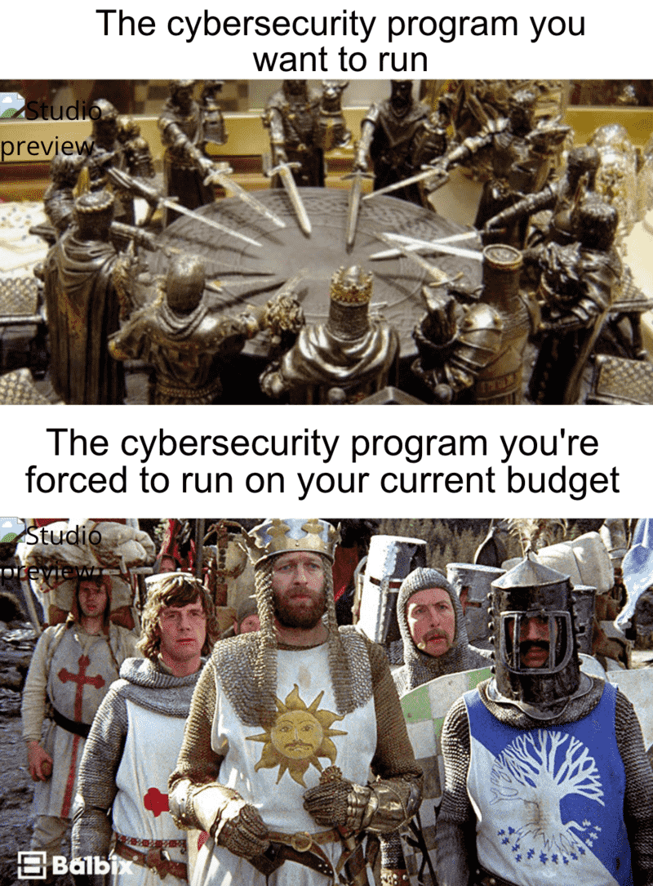

Slide 4
Definitions
Threat
Data vs Intelligence
Pyramid Of Pain
Indicators of Compromise
TTP
OSINT

Slide 5
Types Of Threat Intelligence
Strategic – Long (Multi-Year)
Tactical – Medium (One Year Plus)
Operational – Short (Months)

Slide 6
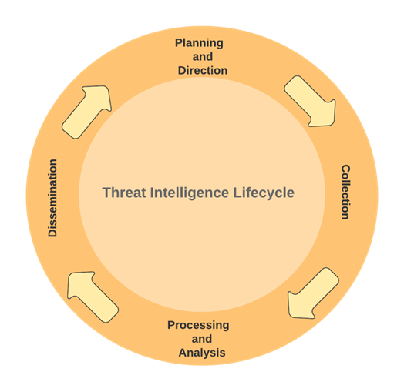
Threat Intel Lifecycle

Slide 7
Key Technologies
TIP (Threat Intelligence Platform)
SOAR (Security, Orchestration, Automation and Response)
Intelligence Feeds
Collections Management
Reporting Tool
MITRE Att&ck Framework

Slide 8
Functions of a Threat Intel Program
Collection
Enrichment of Data
Request For Information/Customers
OSINT
Dark Web/Telegram/Breach Data Monitoring
Analysis of Threats
Education of TTPs/Advisories
Adversary Study

Slide 9
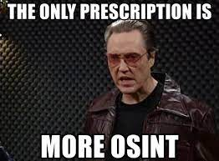
OSINT
www.github.com/sh1katagana1
Types of OSINT
Tooling
Open-Source vs Commercial
Opsec
API Keys

Slide 10
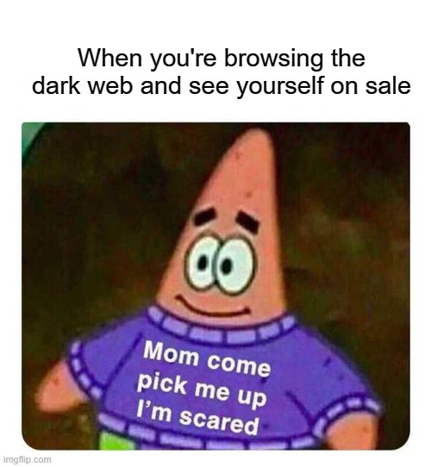
Dark Web/Telegram/Breach Data
Legal Team
Tor
Sock Puppets
Ransomware Leak Blogs

Slide 11
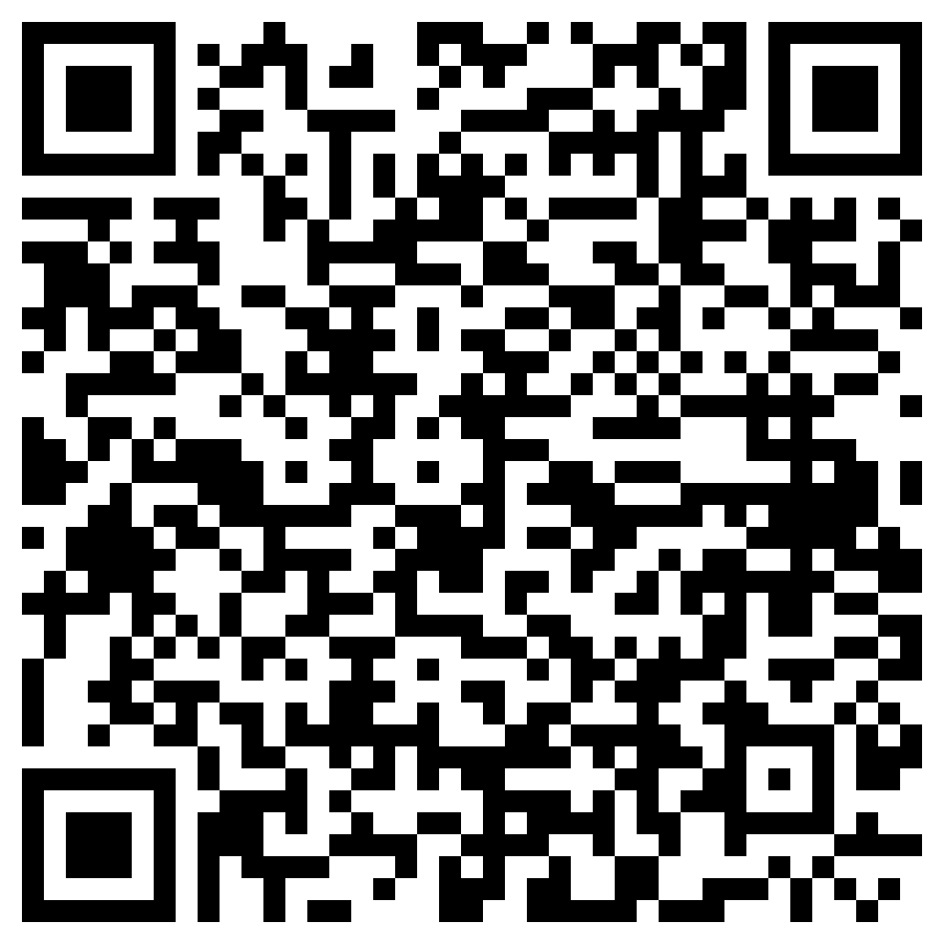
QUESTIONS?
https://www.sh1katagana1.com
https://www.github.com/sh1katagana1
https://www.youtube.com/sh1katagana1
https://sh1katagana1.bandcamp.com
Free song download for attending:
https://www.dropbox.com/scl/fi/jpk3w7mbip8p9fqrsdar4/Crash-Override.mp3?rlkey=2oqw9d69jwalu7i6gm4t81zkc&dl=1

